Slide 1
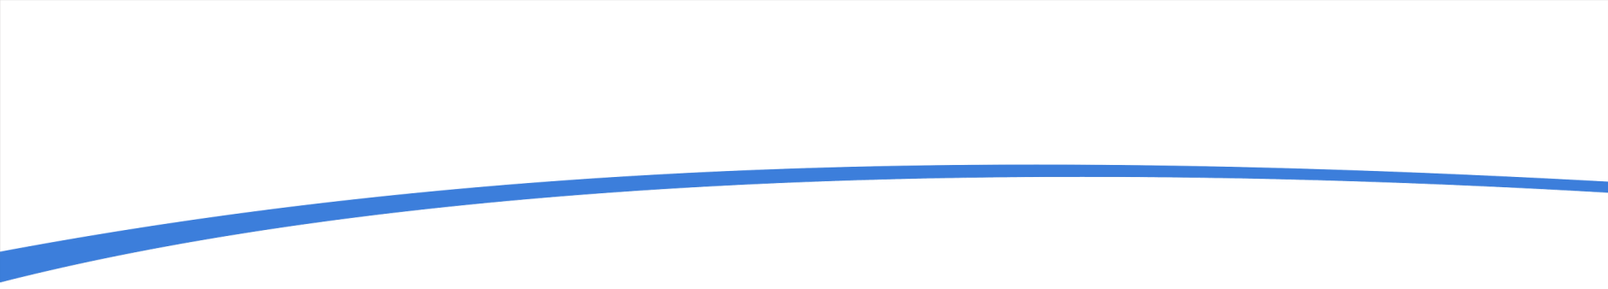


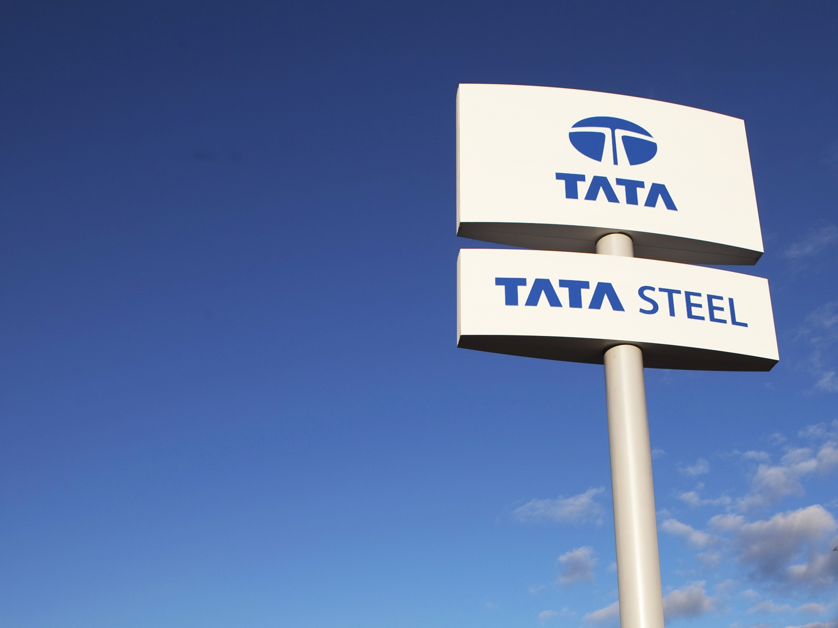
IDENTIFY FACTOR TO ACCELERATE FORCED WEATHERING RATE FOR LD SLAG AT TATA STEEL TO IMPROVE ITS AVAILABILITY
Ajay Kumar GUPTA, Kumar GAURAV

Slide 2
Content
Back Ground
Introduction
Objectives
Experimental Design
Results & Discussion
Conclusion

Slide 3
Background
Steel industry in general, produces large amounts of solid wastes while processing materials through its various processes.
Solid waste management in steel industry is aimed to extract the maximum practical benefits from waste products and to generate the minimum amount of waste to comply with Environmental legislation and regulations and the economics of disposal in the present scenario
According to World steel association on average, the production of one tonne of steel results in around 200 kg of co products for the electric arc furnace (EAF) route and 400 kg for the blast furnace - basic oxygen furnace (BF-BOF) route
The world steel industry applies the principles of reduction, reuse and recycling (3 ‘R’s) in many ways, in order to improve the sustainability of the industry. Understanding of the By-Product generation pattern in all other steel plant will help to identify the gap and scope for reduction the waste generation for Tata Steel.
Proper utilisation of industrial by-product will result in conservation of natural resources, reduce energy consumption, green house gas emission and environmental hazards.
Present study aims to identify those practices and means of absorbing/ adopting/ developing the same for Tata Steel
.

Slide 4
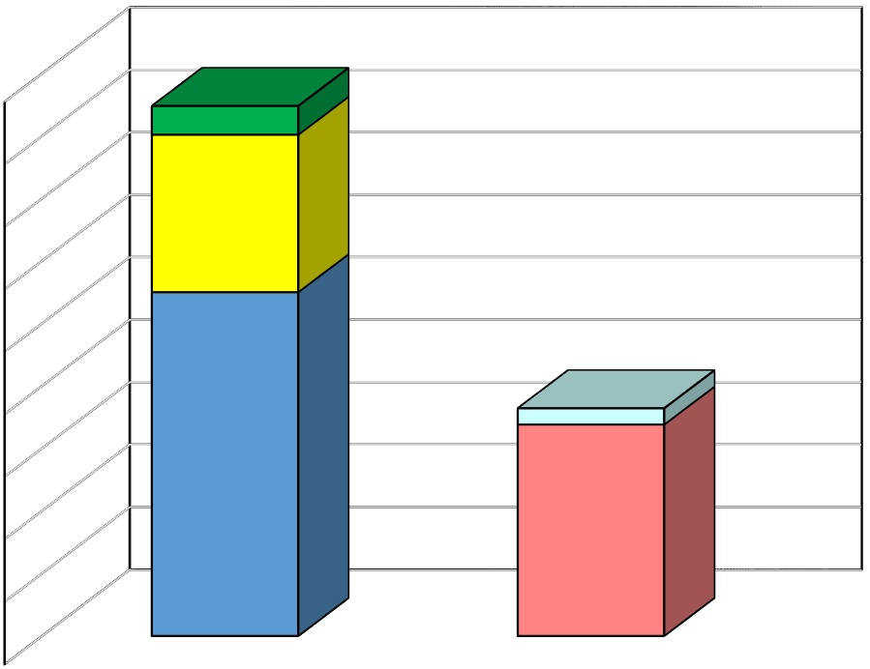
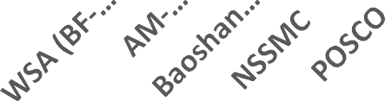


Co-Product generation at Major Steel Plants
1000
800
643
600
 |  |  | 23 WSA 450 400 ₃₅₀ 126 300 13 250 200 ₁₅₀ 275 ₁₀₀ 169 50 0 BF_BOF route EAF route Dust & Sludges (EAF) Steelmaking slag (EAF) Dust & Sludges (BF-BOF) Steelmaking slag (BOF) Ironmaking slag
C | BF Slag
1 | Granulated
2 | Air Cooled
Kg/TCS
424
706
684 363
Co-Products (Kg/Tcs)
400
794
586
558 563
516
522
200
413
452
457
653
0
A
PSW
8 Iron Oxide
B | LD Slag
1 | Metallic
2 | Non- Metallic
1 Flue dust
Fe Bearing
9 muck
2 GCP sludge
3 Lime Fines
10 ESP/DE Dust
Coal Tar
11 Sludge
4 LD Sludge
5 Kiln Dust
6 Mill Scale
7 Mill Sludge
Source: World Steel association & Sustainability Report

Slide 5
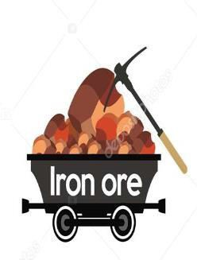






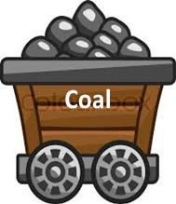
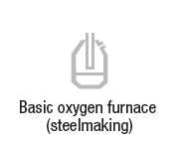

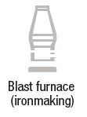








Steel making by-products and their Uses
Major Application Area
Input
Output
Steel
By -Products
Slags
Process
Basic Oxygen furnace steel making
Dust and Sludge
 |  | Internal and external usage of iron oxides and alloying elements
Chemicals
Input material for
chemical Industry
Process Gas
Heat and Electricity
Used Oils
Reducing agent
Waste
Source : WSA

Slide 6
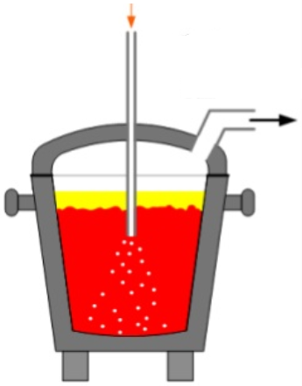
Production of LD slag
Iron Making
Steel Making
Hot metal
DS Hot Metal
Molten Steel
Refined Molten Steel
BF slag
DS Slag
BOF slag
Laddle Furnace Slag

Slide 7
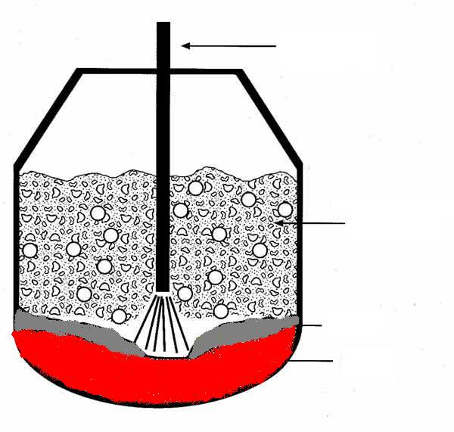
Process Flow (Metal Recovery Plant)
Input
Process
Application
Slag Storage
(LD Slag, LF Slag and DS slag etc.)
Slag from
LD Shops
-300 mm
Oxygen Lance
Screening (300x300sq.mm)
Magnetic Segregation &
Separation
0-6 mm
+300mm
Gas
Slag
Metal
Emulsion
Balling/Lancing
In Process
Sampling
6-20 mm
20-60 mm
LD Slag
Metal
80-300 mm
Manual Segregation &
Processing
(Outside slag pit)
+300 mm

Slide 8
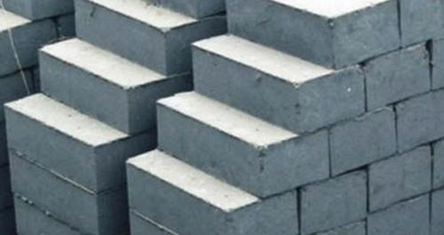
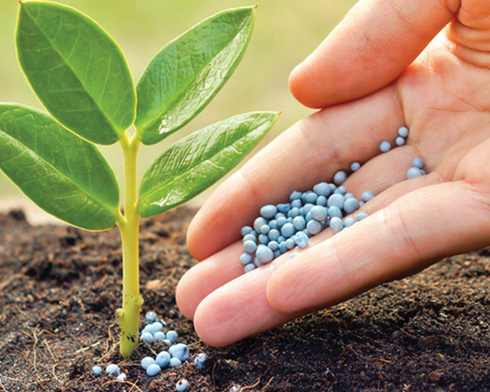
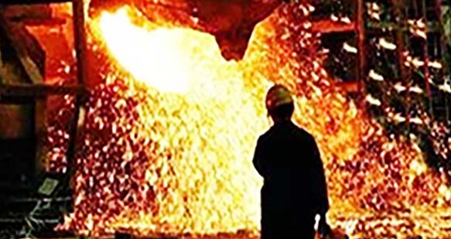
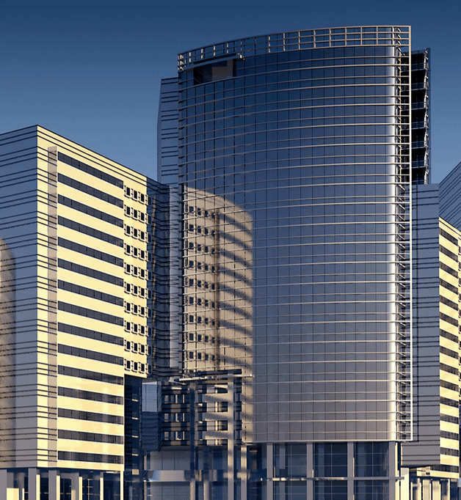
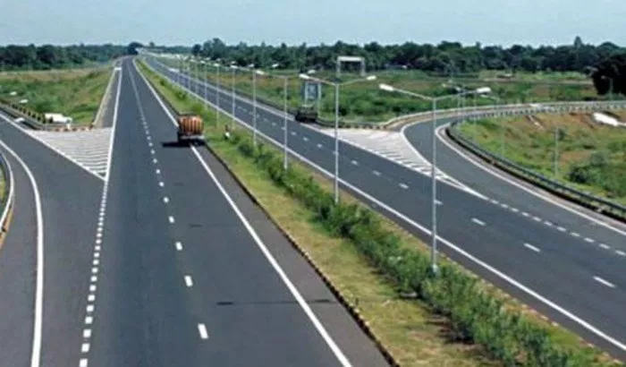
LD slag application area in Tata Steel
Tata Steel approximately generates 2.0 MT LD slag per annum.
In Fy-18 the utilization rate of LD slag is around 58%.
After recovering the metallic content (`15% to 20%) around 10% material is used in sinter making.
Rest are sold to external market for brick making, Road making and cement making.
Amongst all the external utilization Brick making and hardstand are the two most important application area.

Slide 9
Challenges associated with LD slag
Chemistry:
  Steel making slag is comprised of lime, silica and iron oxide
  it is possible to use in BF-ironmaking and steelmaking to replace lime and recover iron.
  High P content restricts its utilisation
  High Free lime content
Physical properties:
  High Hardness and wear resistance : harder to crush compared to lime stone
  Glass content significantly low compared to BF slag
Component | LD slag | BF slag | LD slag Restrictions / Disqualifies
Fe % | 20.63 | 0.47 | Cement use
P % | 1.11 | < 0.1 | Sinter Plant/ Blast Furnace Restriction

Slide 10
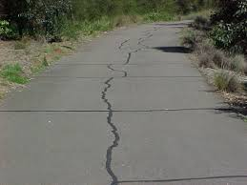
Objective and scope of work
LD slag is a by-product of the steel refining processes.
The lime and magnesia present in LD-slag absorb moisture and CO₂ from atmosphere to form hydroxides and carbonates respectively which lead to the volume expansion or swelling resulting in crack formation in road and building materials.
This problem can be overcome by weathering the slag for six to nine months for hydration of free lime before the slag is used.
Objective:-
  Identify factors affecting weathering process.
  To reduce the weathering time of LD slag through experiment.

Slide 11
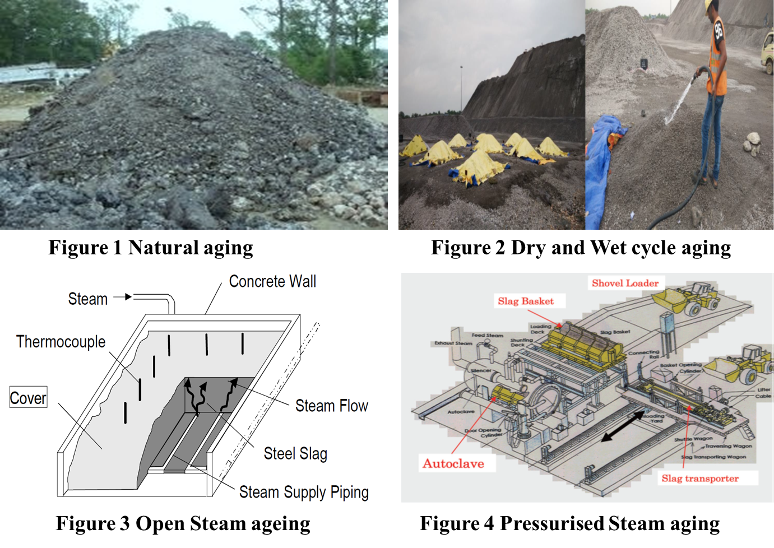
Types of weathering process
Natural aging : It takes more than a year and needs lot of land as the ageing time is approx.1.5 years.
Dry and Wet cycle aging : It takes about 4 -6 months to age the slag but the uniformity is not ensured. It also needs large tracts of land.
Open Steam ageing : In this method the steam is passed through the slag to age it and it takes 2 to 4 days
Pressurised Steam aging : It is quick and needs less area but is very costly to set up and run such a plant. This process takes around 6 to 8 hrs.
Factors affecting Dry and wet cycle ageing
1. stockpile size, its characteristics & storage conditions
2. Particle size
3. Water Quality
4. Time of weathering

Slide 12
Need of LD slag weathering
CaCO₃
Calcium Carbonate
(Density = 2.71 g/cc)
CaO
Calcium Oxide
(Density = 3.34 g/cc)
Ca(OH)2
Calcium Hydroxide
(Density = 2.21 g/cc)
Volume Expansion of LD slag = 5.85
Acceptable Volume Expansion for use in road making = < 2 % (BIS standard)
Lime Cycle: This cycle occurs for both high calcium lime and Dolomitic lime products.
Re-carbonation
Ca(OH)₂+CO₂ → CaCO₃ + H₂O +Heat
Calcination
CaCO₃ +Heat→ CaO + CO₂
Hydration of lime
CaO + H₂O → Ca(OH)₂₊ Heat
Compound | Specific Gravity(g/cc)
MgO | 3.6
Mg(OH)₂ | 2.34
MgCO₃ | 2.96

Slide 13
Design of Experiment
Selected parameters:
Amount of Water
pH of water
Frequency of mixing stockpile/Agitation
Schedule for testing and processing :
Cycle Time | Lime Test | Other Tests
7 days | 15 days | 30 days
In pile P1 - pond water & pH level is around 9 to 11.
In pile P2 - pond water is being processed with acetic acid to lowering down the pH level from higher (9 to 11) to normal (6 to 7).
In pile P3 - Bore well water to simulate the natural water pH.

Slide 14
In pile W1, W2 and W3 - quantity of water. The frequency of water is being increased from W1 to W3 with fixed shuffling constancy
In pile S1, S2 and S3 – Frequency of shuffling . The frequency of shuffling is being decreased from S1 to S3 with fixed water quantity.

Slide 15
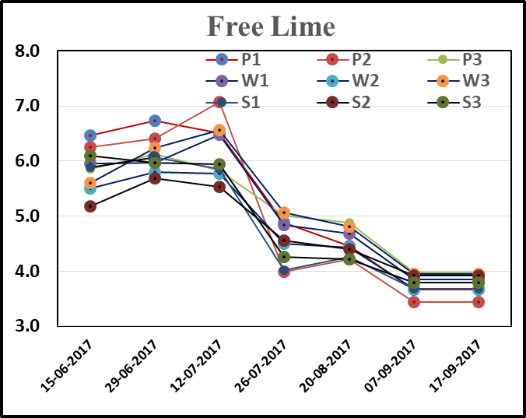
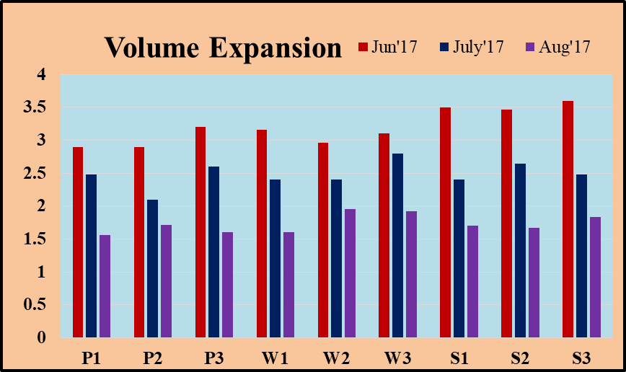
Results & Discussion
The starting free lime contains are varying from 5.17 % to 6.47 whereas final lime contain has reduced up to 3.5% to 4.0%.
After one month treatment, volume expansion are varying between from 2.9 % to 3.5%, the final volume expansion has came down below than 2% which is desired as mentioned in BIS the standard for application in road making.

Slide 16
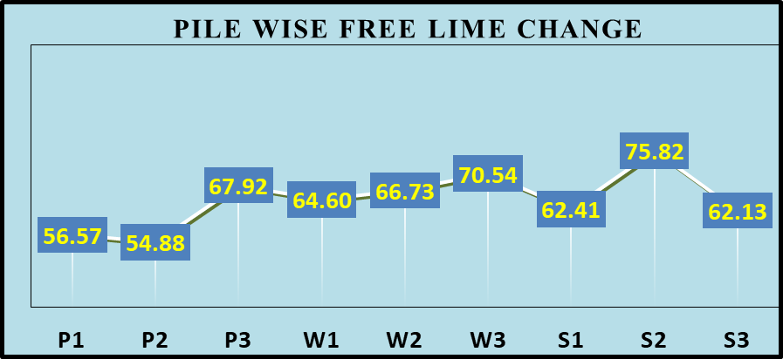
Results & Discussion
The maximum lime % were decreased up to 75% in pile no S2 in which shuffling had done in every two days followed by watering and drying. The volume expansion value was also 1.67%.
Percentage reduction in free lime content over a period of three months varied within a range of 45% to 50% for specially treated LD slag samples.
Similarly, percentage reduction in volume expansion over a period of three months varied within a range of 68% to 70% for specially treated LD slag samples.

Slide 17
Conclusion
The experiments were carried out using a 6 to 20 mm fractions of LD slag.
Time for weathering reduced by 50 %
Another major observation is that though frequency of water spraying and reshufflings played a major role in reducing the treatment time for LD slag to stabilize, no such impact was observed with changes in quality of water.
Other tested parameters were showing encouraging results in term of soundness, water absorption, specific gravity, bulk gravity, Impact value, Los abrasion Impact, Flakiness Index

Slide 18
THANK YOU

